Slide 1
ICS (CCA) PRESENTATION “SQLmap”
By:
PB 5 Ameya Khire
PB 16 Sahil Ranawade
PB 32 Deven Chhajed

Slide 2
What is SQLMAP?
A penetration testing tool called sqlmap is an open source tool for detecting and exploiting SQL injection flaws, or taking over databases by automated means.
A SQL injection attack attempts to gain access to a web application's database by executing malicious SQL queries. By executing the right set of queries, the attacker is able to control a web application's database. so, this is exactly what is SQLMap.
SQLMAP tests whether a ‘GET’ parameter is vulnerable to SQL Injection
it's a Python-based tool

Slide 3
Features of SQLmap
Connecting directly to the database without using SQL injection is possible with DBMS credentials, IP address, port, and database
A dictionary-based cracking program can automatically recognize password hash formats
Users, password hashes, roles, hashes, databases, tables and columns can be enumerated
The user can choose to dump whole database tables, ranges of entries, or only certain columns of a table depending on their choice.
Support for custom injection payloads and Support for tamper scripts
Ability to exploit SQL injection vulnerabilities

Slide 4
USE CASES
For attacker
For defender
Attackers can use the tool to get into a database, and potentially the server!
Defenders can use sqlmap for penetration testing of their web applications, servers, and databases

Slide 5
SqlMap - Target Options:
-d Direct -> Direct connection to database
-u URL -> Target url
-l Logfile -> Parse targets from url or Webscrap proxy logs
-m Bulkfile -> Scan Multiple targets from a text file
-r Prerequisite -> Load HTTP request from a file
-g Google Dork-> Process google dorks as target urls
-c Configue -> Load Options from a custom configuration file
Different kinds of Sql injection testing:
B: Boolean based blind
E: Error-based
U: Union query based
S: Stacked queries
T: Time based blind
Q: Inline queries

Slide 6
Getting Started with sqlmap
sudo apt-get install sqlmap
SQLMAP comes pre – installed with kali linux, which is the preferred choice of most penetration testers. However, you can install sqlmap on other Debian basded linux systems with the following command:
sudo apt-get install sqlmap
the command
we will make use of a website that is designed with vulnerabilities for demonstration purposes:
http://testphp.vulnweb.com/listproducts.php?cat=1

Slide 7
Overview
-Techniques -crawl -enumeration
-Batch - Risk - Levels
-Thread - Verbosity -Proxy
--forms -- data -- headers
--user-agent --cookie --flush-session
--output-dir --tamper

Slide 8
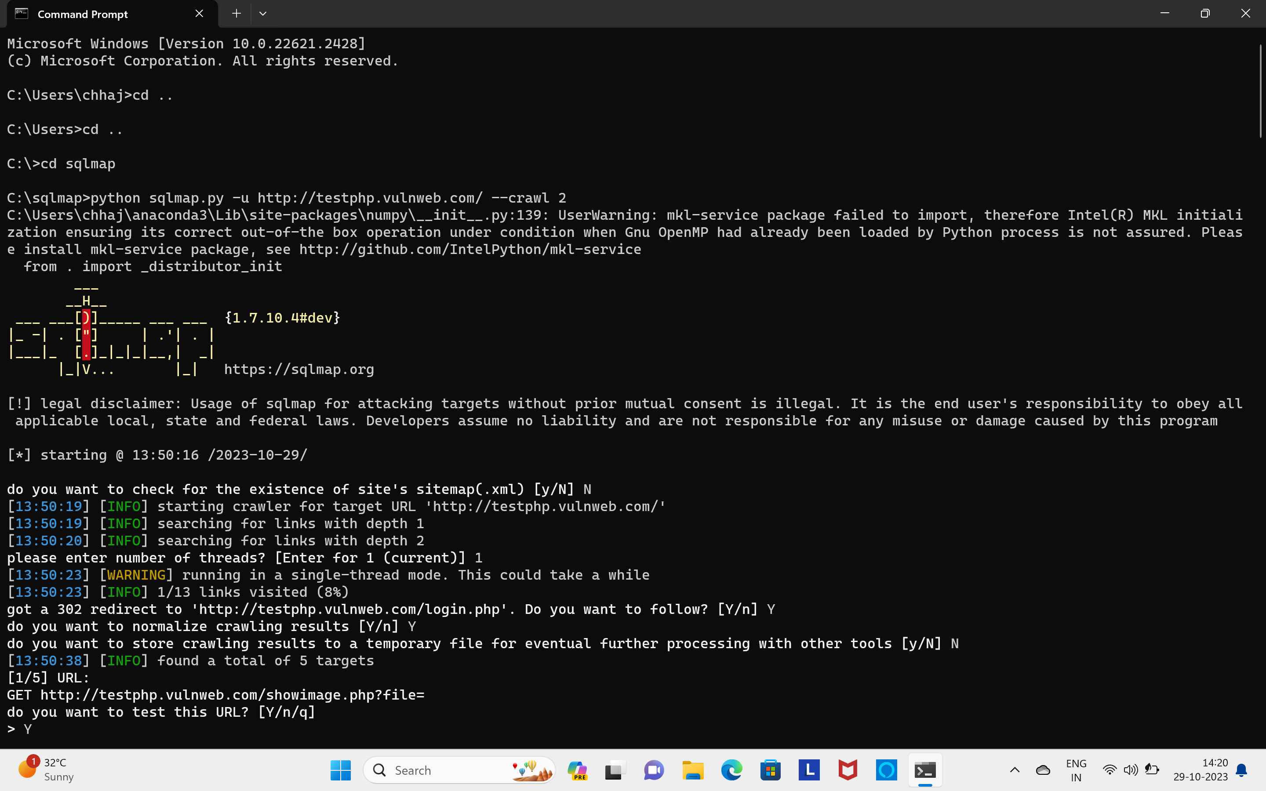

Slide 9
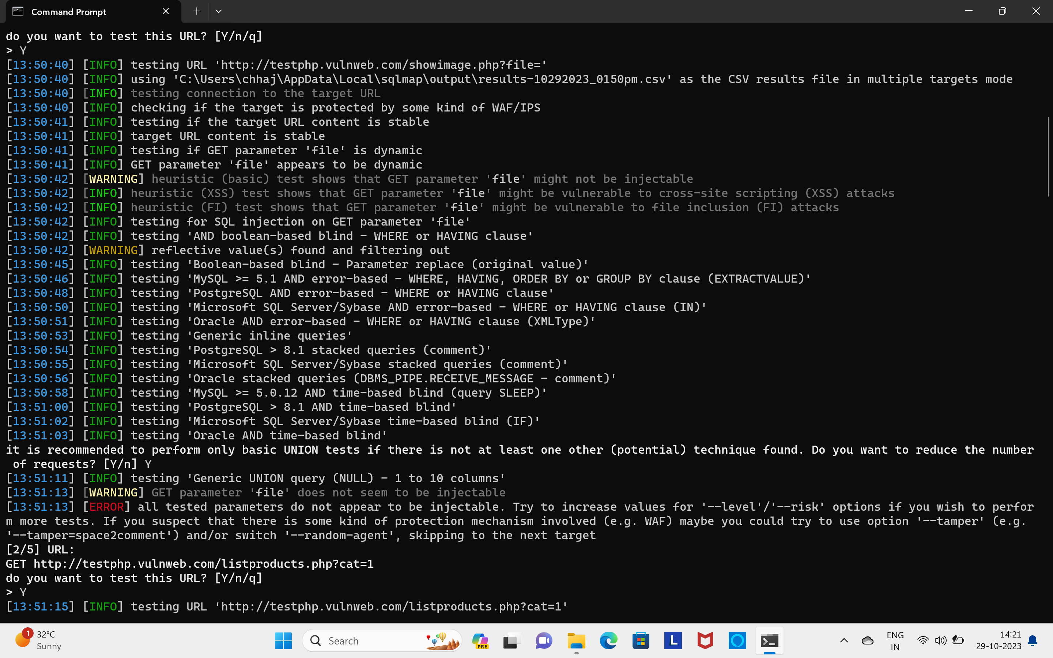

Slide 10
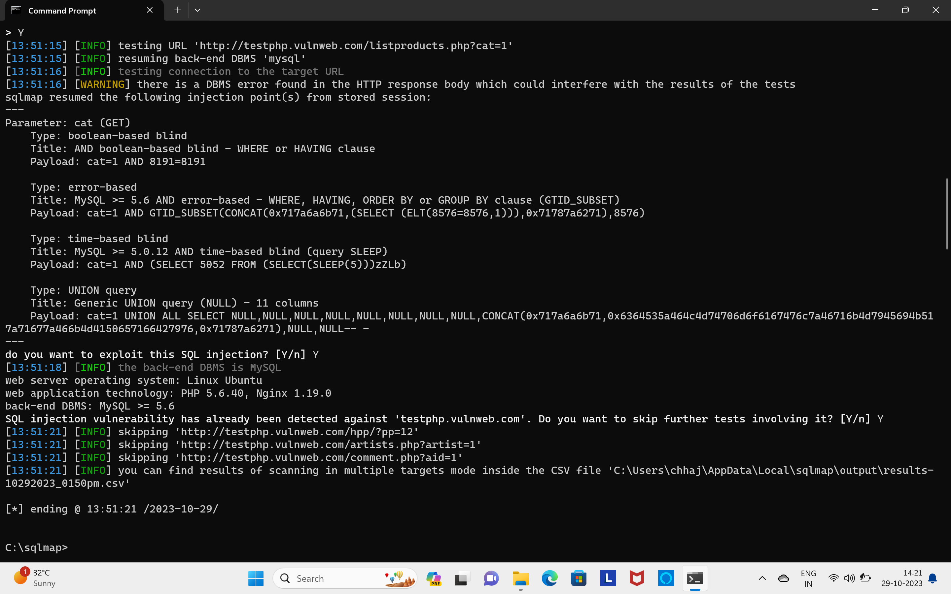

Slide 11
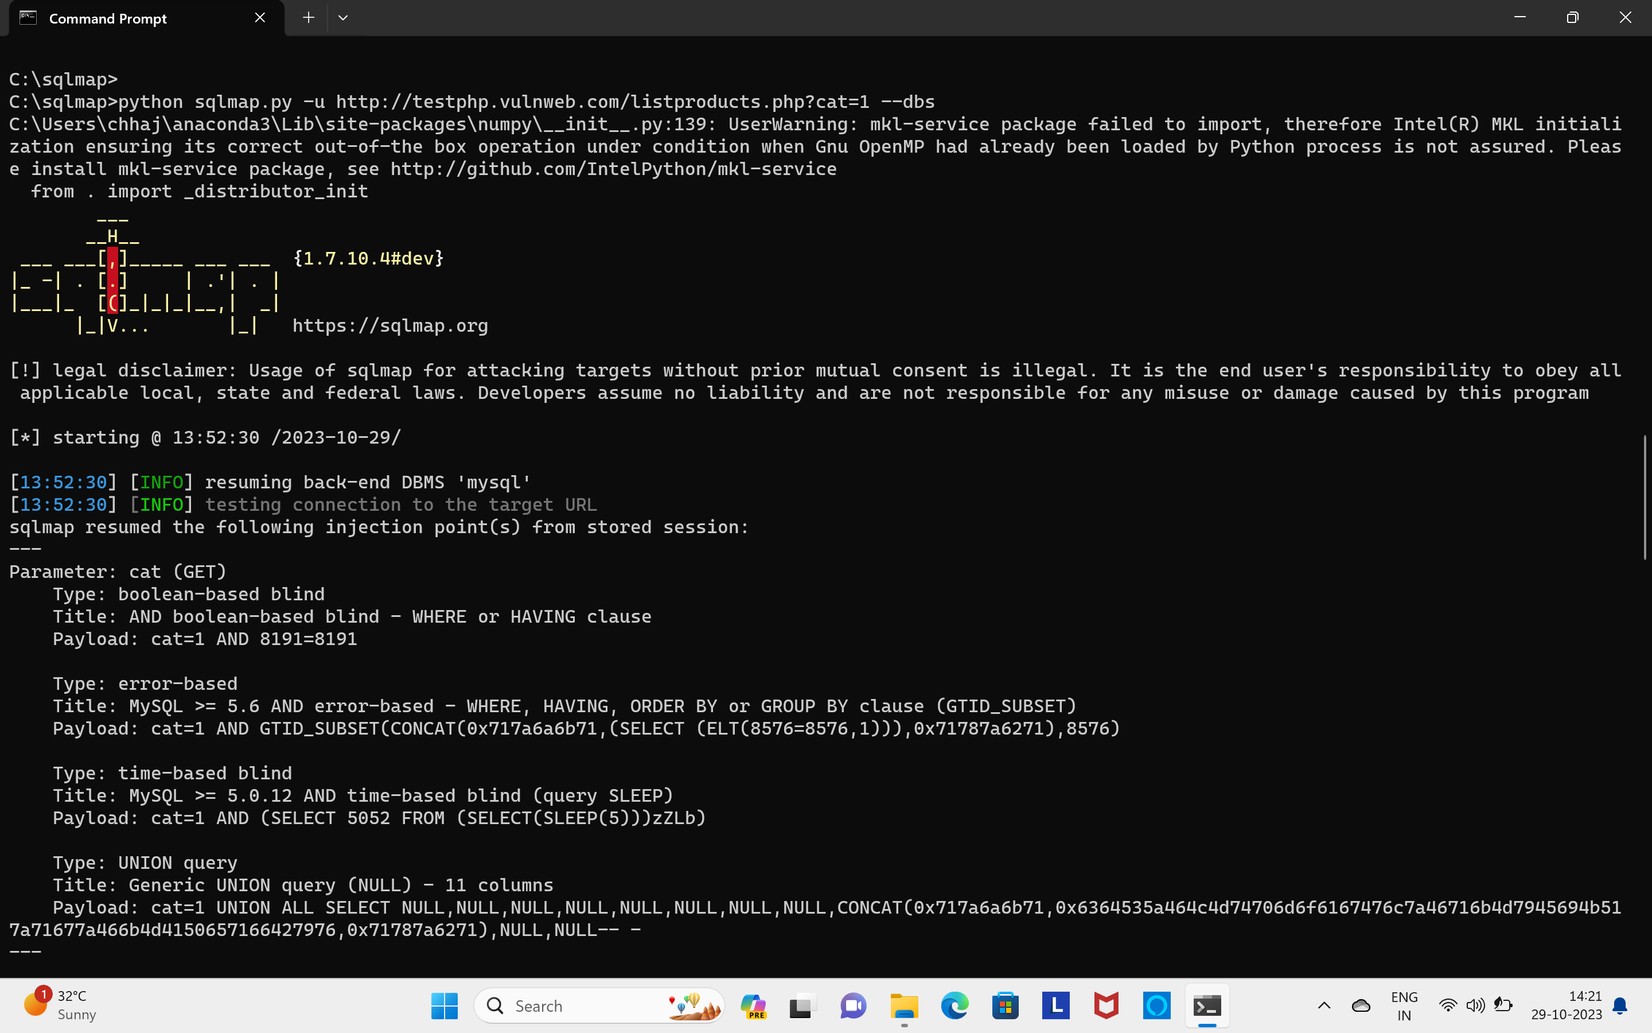

Slide 12
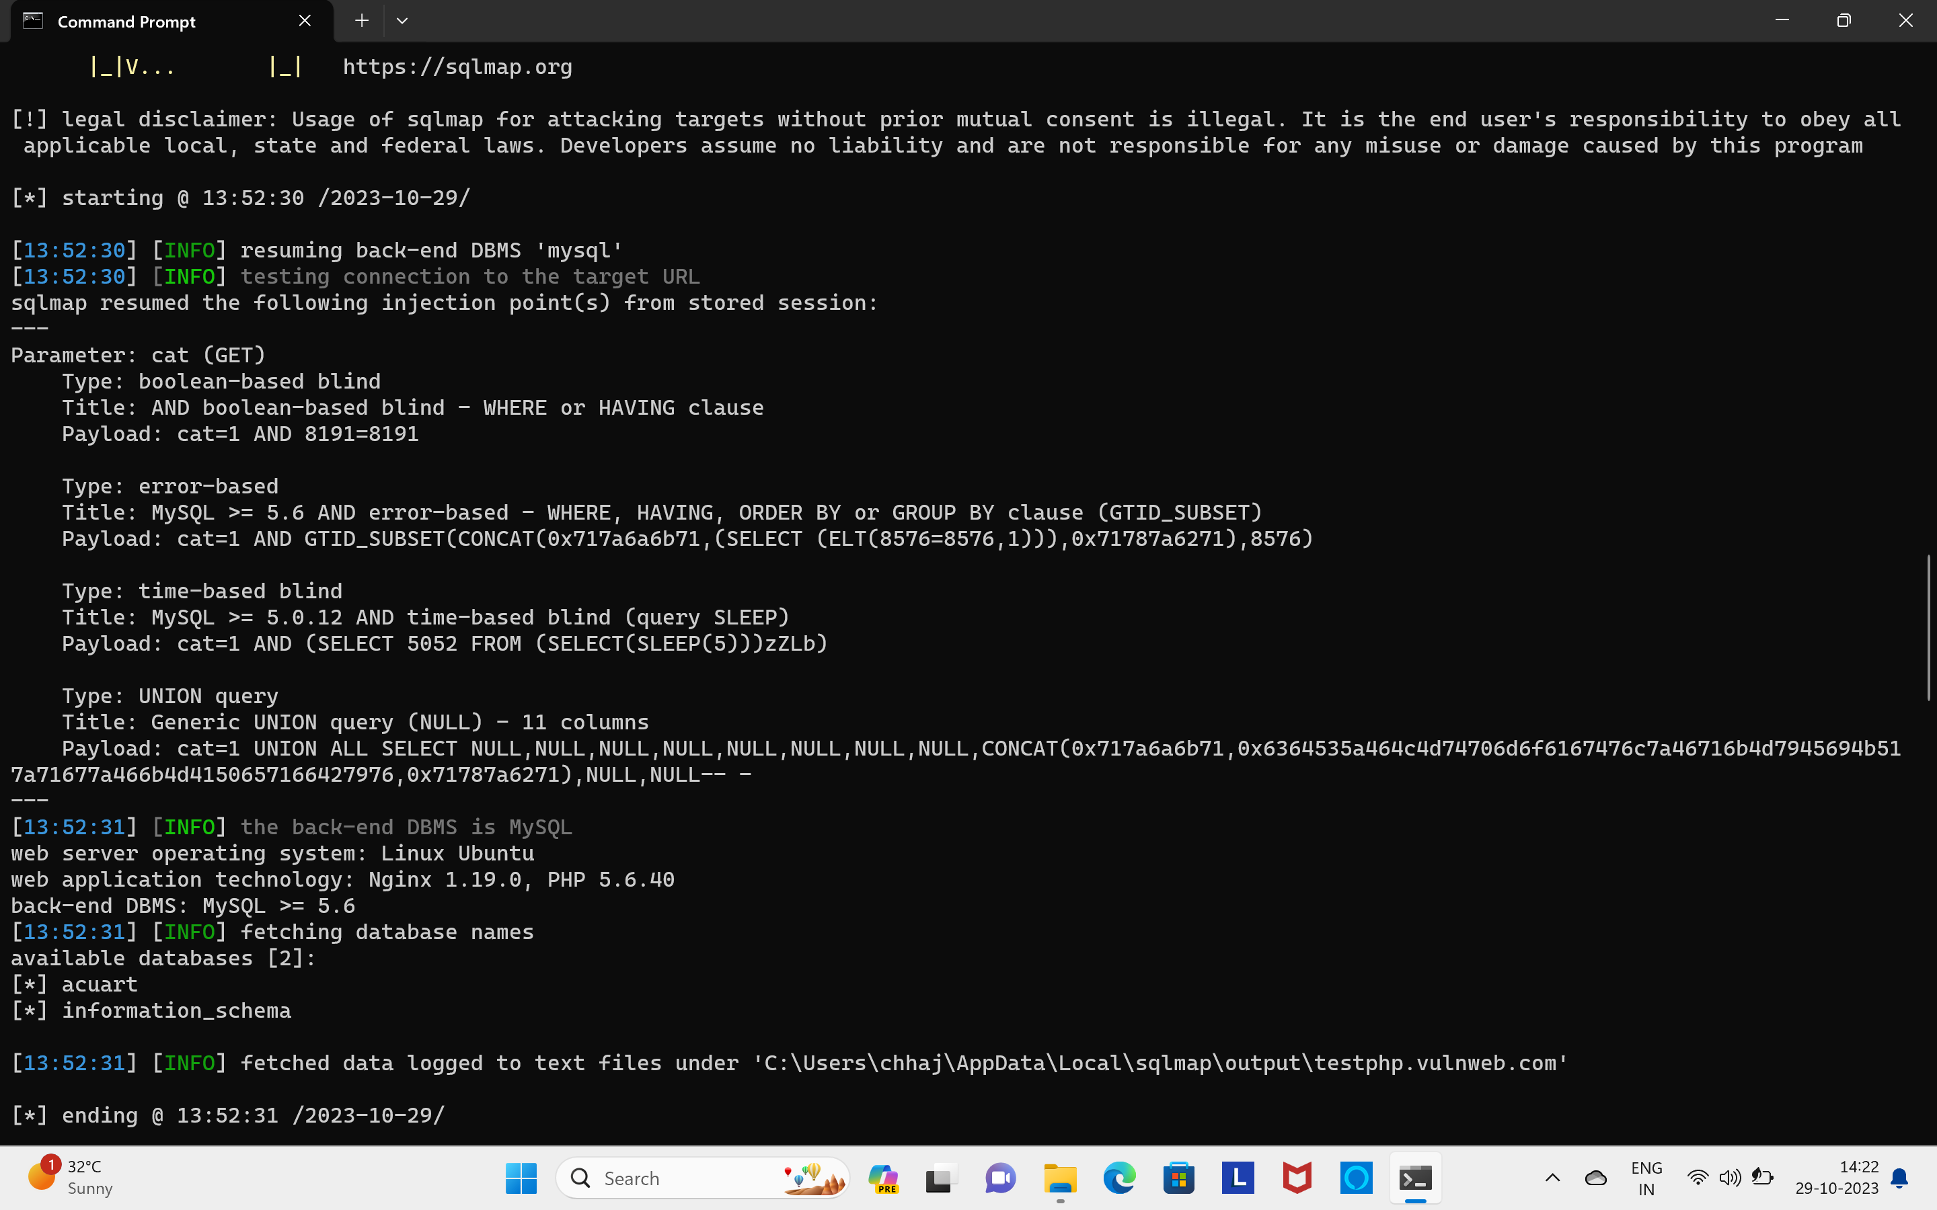

Slide 13
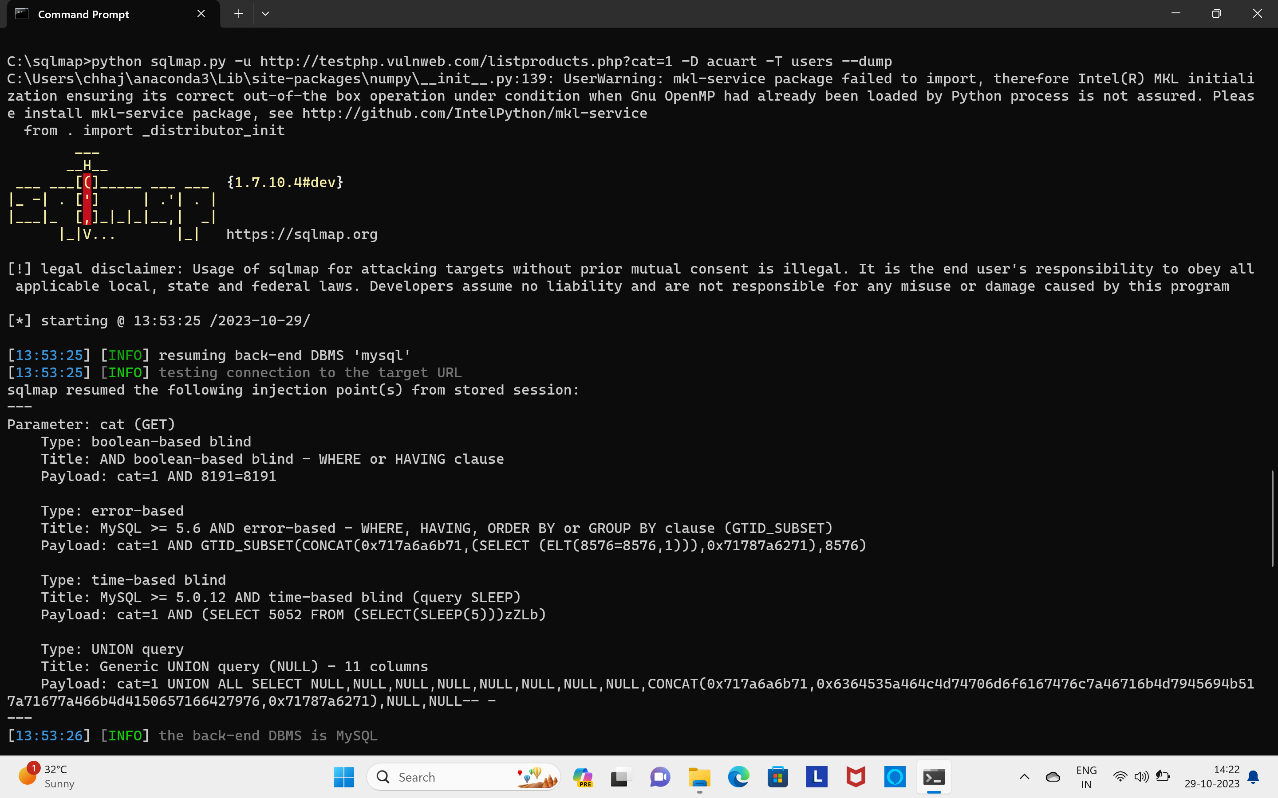

Slide 14
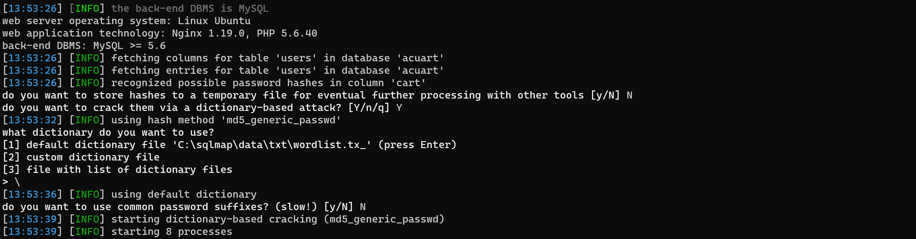

Slide 15
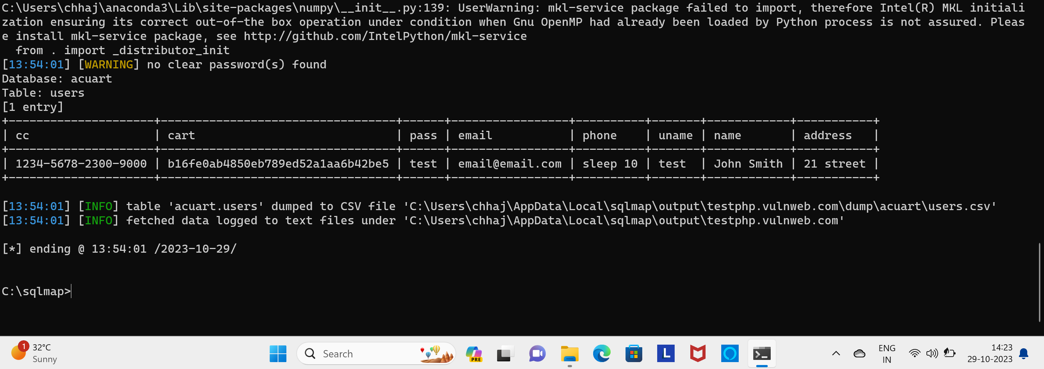

Slide 16
How to prevent sql injection attacks?
Trust no one
Don’t rely on dynamic sql queries
Update patch and repeat
Use Firewalls
Grant only essential privileges
Use cryptography often
Disclose only necessary information

Slide 17
Summary
Databases are the backbone of every business.
Updating , maintaining and securing databases is essential to protect them from malicicious actors.
SQLmap is a powerful tool that helps us audit database vulnerabilities . It is important for developers and security professionals to be faimilar with SQLmap for defending against SQL injection attacks.

Slide 18
References
https://www.freecodecamp.org/news/how-to-protect-against-sql-injection-attacks/
https://sqlmap.org/
https://youtu.be/2YD4vygeghM
https://youtu.be/iD84waJKYh0
https://www.kali.org/tools/sqlmap/
https://www.comparitech.com/net-admin/sqlmap-cheat-sheet/

Slide 19
THANK YOU!!

